Slide 1

ESSENTIALS OF MARKETING RESEARCH
Hair/Wolfinbarger/Ortinau/Bush

Slide 2

Explain the role of sampling in the research process
Distinguish between probability and nonprobability sampling
Understand the factors to consider when determining sample size
Understand the steps in developing a sampling plan

Slide 3

Sampling is the process
of selecting a small number of elements
from a larger defined target group
of elements such that
the information gathered
from the small group will allow judgments
to be made about the larger groups

Slide 4

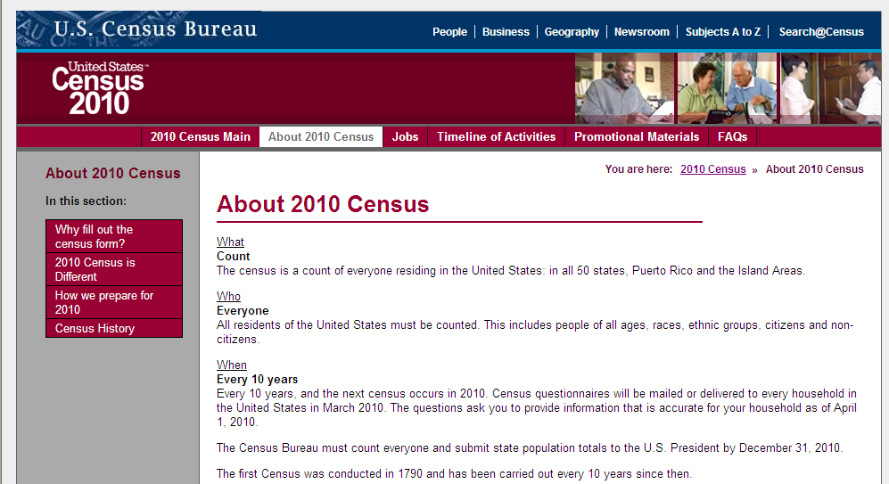

Slide 5

Population
Element
Defined target
population
Sampling unit
Sampling frame

Slide 6

Sampling error is any type of bias
that is attributable to mistakes
in either drawing a sample or
determining the sample size

Slide 7

Define the Population of Interest
Identify a Sampling Frame (if possible)
Select a Sampling Method
Determine Sample Size
Execute the Sampling Plan

Slide 8

Population of interest is entirely dependent on Management Problem, Research Problems, and Research Design.
Some Bases for Defining Population:
  Geographic Area
  Demographics
  Usage/Lifestyle
  Awareness

Slide 9

A list of population elements (people, companies, houses, cities, etc.) from which units to be sampled can be selected.
Difficult to get an accurate list.
Sample frame error occurs when certain elements of the population are accidentally omitted or not included on the list.
See Survey Sampling International for some good examples
http://www.surveysampling.com/

Slide 10

Probability
sampling
Nonprobability
sampling

Slide 11

Probability
Simple random sampling
Systematic random sampling
Stratified random sampling
Cluster sampling
Nonprobability
Convenience sampling
Judgment sampling
Quota sampling
Snowball sampling

Slide 12

Simple random sampling is a method of
probability sampling in which
every unit has an equal nonzero
chance of being selected

Slide 13

Systematic random sampling is a
method of
probability sampling
in which the defined
target population is ordered
and the sample is selected
according to position using a skip interval

Slide 14

1: Obtain a list of units that contains an acceptable frame of the target population
2: Determine the number of units in the list and the desired sample size
3: Compute the skip interval
4: Determine a random start point
5: Beginning at the start point, select the units by choosing each unit that corresponds to the skip interval

Slide 15

Stratified random sampling is a
method of
probability sampling
in which the population is divided
into different subgroups and samples
are selected from each

Slide 16

1: Divide the target population into homogeneous subgroups or strata
2: Draw random samples fro each stratum
3: Combine the samples from each stratum into a single sample of the target population

Slide 17

Convenience sampling relies
upon convenience and access
Judgment sampling relies upon belief
that participants fit characteristics
Quota sampling emphasizes representation
of specific characteristics
Snowball sampling relies upon respondent
referrals of others with like characteristics

Slide 18

Research objectives
Degree of accuracy
Resources
Time frame
Knowledge of
target population
Research scope
Statistical analysis needs

Slide 19

How many completed questionnaires do we need to have a representative sample?
Generally the larger the better, but that takes more time and money.
Answer depends on:
  How different or dispersed the population is.
  Desired level of confidence.
  Desired degree of accuracy.

Slide 20

Common Methods:
  Budget/time available
  Executive decision
  Statistical methods
  Historical data/guidelines
    See Table

Slide 21

Variability of the population characteristic under investigation
Level of confidence desired in the estimate
Degree of precision desired in estimating the population characteristic

Slide 22
Probability Sampling and Sample Sizes
When estimating a population mean
  n = (Z²_{B,CL})(σ²/e²)
When estimates of a population proportion are of concern
  n = (Z²_{B,CL})([P x Q]/e²)
  For a simple sample size calculator, click here:
  http://www.surveysystem.com/sscalc.htm

